Slide 1

Speech-to-Text Analysis Under the guidance of Prof. Tony Diana
By:
Krishna Sai Biradar
Sasidhar Guthi
Suresh Ganta

Slide 2
Introduction
You may be frequently using Google Assistant or Apple’s Siri or Amazon Alexa to find out quick answers on the web or to simply command something. These AI assistants are well known for understanding our speech commands and performing the desired tasks.
Nearly 20% of people in the world are suffering from various disabilities, many of them are blind or unable to use their hands effectively they can share their information with people by operating a computer through voice input.
Our project is capable to recognize the speech and convert the input audio to text and enables a user to perform operations such as Summarization, Name Entity Recognition, Sentiment Analysis and Translation.

Slide 3
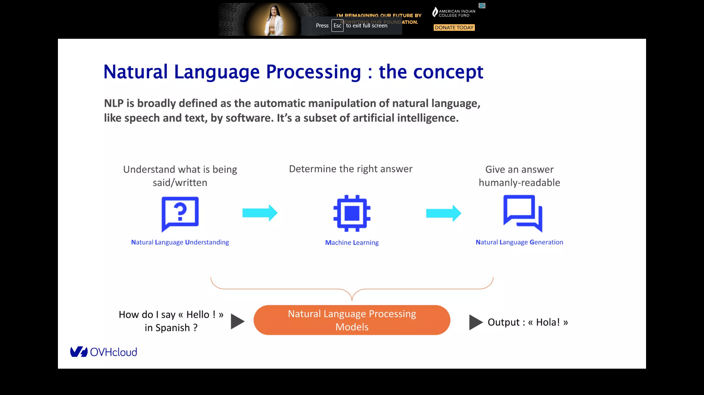
Natural Language Processing
NLP is broadly defined as the automatic manipulation of natural language, like speech and text, by software. It’s a subset of artificial intelligence.

Slide 4
Streamlit
Streamlit is an open-source app framework for building web apps for Machine Learning.
Streamlit is easy to deploy and requires very less code.
The same way we write a python code streamlit allows us to write code for an app.
Hugging Face
Most popular open-source natural language processing(NLP) library
A community hub with more than 4,000 models that provides API for easy access.
NLP took a turn in 2019 with the arrival of transformers architecture

Slide 5
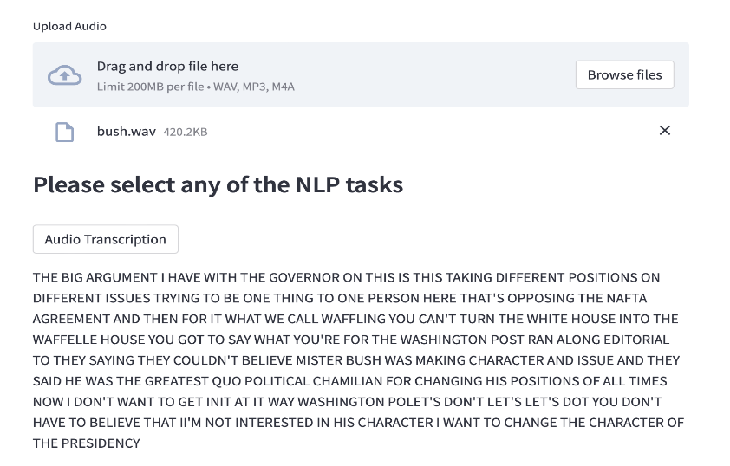
Audio Transcription
We have taken various audio files in .wav format.
After uploading these audio files we used the HuBERT model for Audio Transcription.
Audio transcription converts the audio files into text.
Audio transcription is more effective to deliver information in today’s data-driven market.

Slide 6
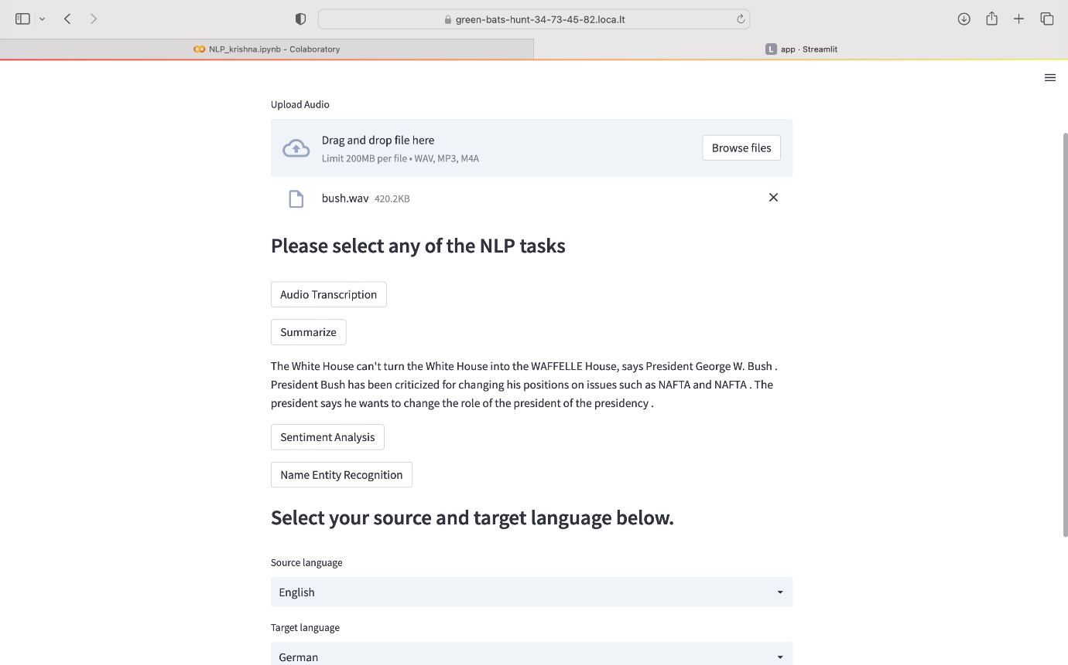
Summarization
Summarization is, taking a large selection of text and then reducing it to smaller pieces and finding the main key idea of the text.
The transcribed text is taken as input to get a summarized output.
We have used the BART model for Summarization.

Slide 7
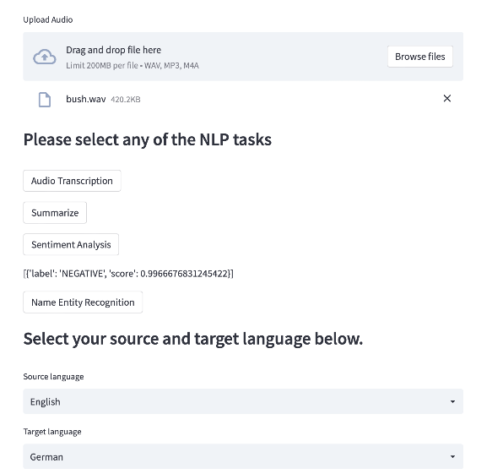
Sentimental Analysis
Sentiment Analysis helps us to analyze emails, product reviews, tweets, monitor your brand reputation on social media etc.
We have used the DistilBERT model for Sentimental Analysis.

Slide 8
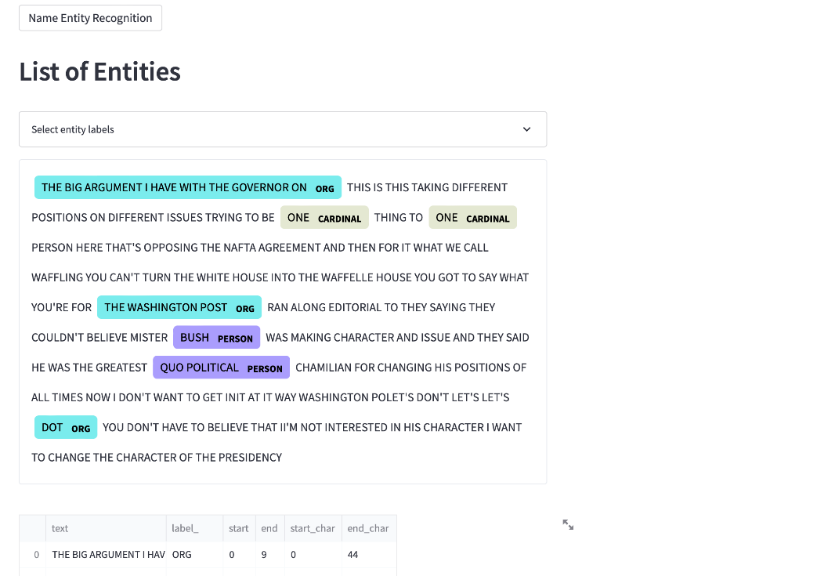
Named Entity Recognition
Named entity recognition is the automatic identification and counting of occurrences of named entities in a collection of information.
We have used the transcribed text as input.
We have used Spacy for named entity recognition.

Slide 9
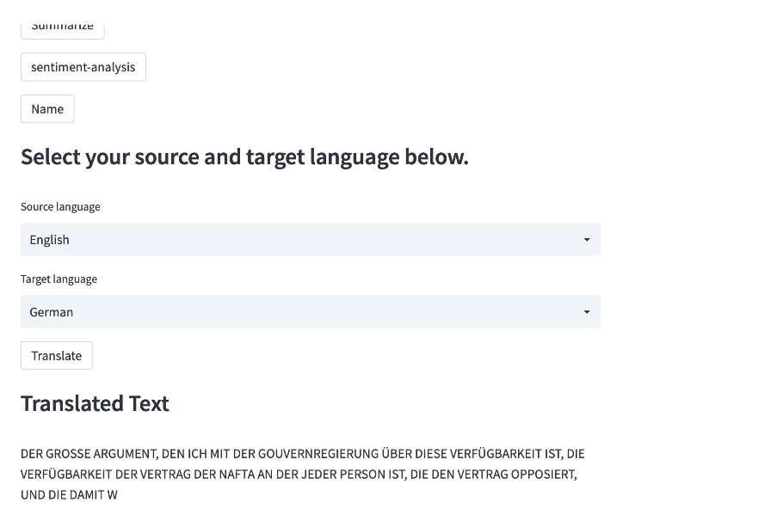
Translation
Translation is performed for the given input from English to the desired Language
According to the User’s preference different languages could be added.
We have used one of the models in Spacy, en_core_web_sm for translation.

Slide 10
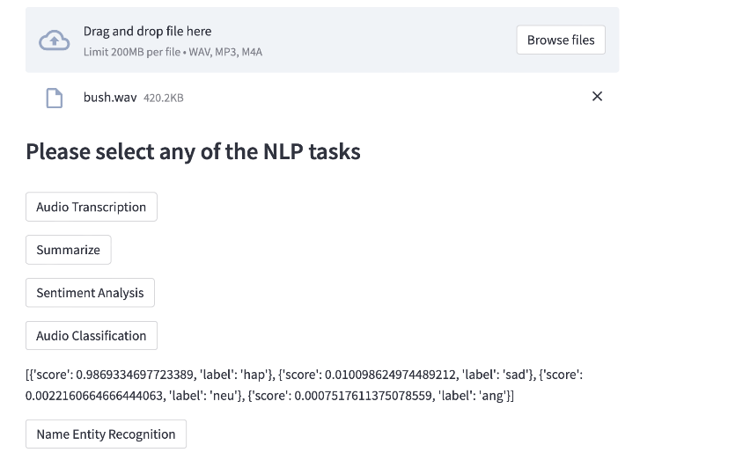
Audio Classification
Audio Classification is predefining categories in the text documents provided.
It plays a vital role to manage and process a vast amount of documents in digital forms that are widespread and continuously increasing.
We have used the Speech processing Universal PERfomance Benchmark(SUPERB) model for Audio Classification.

Slide 11

Demo

Slide 12
Challenges And Future Improvements
The processing power of the local machines was not enough, which required the use of Google Colab Pro. But even after taking Google Colab Pro, we were not able to process more than 1MB of the audio file.
Users would like to upload files with different formats, but since mp3 file quality was not sufficient for the models to process speech to the text, we were confined to using wav format files – Challenging audio files
High accuracy for low-quality audio files.
Data Protection – Consent, Security, and Privacy.

Slide 13
Conclusion
In this project we have tried to cover the main trends in NLP from recurrent networks and how hugging face has democratized the use of NLP through its platform.

